Slide 1
William Stallings
Computer Organization and Architecture
7th Edition
Chapter 4
Cache Memory

Slide 2
Suggested Videos to watch
S/No | Title | Link
 | An overview of PC memory Types | https://youtu.be/ygElbzv1S_w
 | RAM explained | https://youtu.be/PVad0c2cljo

Slide 3
Characteristics
Location
Capacity
Unit of transfer
Access method
Performance
Physical type
Physical characteristics
Organisation

Slide 4
Location
CPU
Internal
External

Slide 5
Capacity
Word size
  The natural unit of organisation
Number of words
  or Bytes

Slide 6
Unit of Transfer
Internal
  Usually governed by data bus width
External
  Usually a block which is much larger than a word
Addressable unit
  Smallest location which can be uniquely addressed
  Word internally
  Cluster on M$ disks

Slide 7
Access Methods (1)
Sequential
  Start at the beginning and read through in order
  Access time depends on location of data and previous location
  e.g. tape
Direct
  Individual blocks have unique address
  Access is by jumping to vicinity plus sequential search
  Access time depends on location and previous location
  e.g. disk

Slide 8
Access Methods (2)
Random
  Individual addresses identify locations exactly
  Access time is independent of location or previous access
  e.g. RAM
Associative
  Data is located by a comparison with contents of a portion of the store
  Access time is independent of location or previous access
  e.g. cache

Slide 9
Memory Hierarchy
Registers
  In CPU
Internal or Main memory
  May include one or more levels of cache
  “RAM”
External memory
  Backing store

Slide 10

Memory Hierarchy - Diagram

Slide 11
Performance
Access time
  Time between presenting the address and getting the valid data
Memory Cycle time
  Time may be required for the memory to “recover” before next access
  Cycle time is access + recovery
Transfer Rate
  Rate at which data can be moved

Slide 12
Physical Types
Semiconductor
  RAM
Magnetic
  Disk & Tape
Optical
  CD & DVD
Others
  Bubble
  Hologram

Slide 13
Assignment to MS
Please read about electromagnetic spectram.

Slide 14
Physical Characteristics
Decay
Volatility
Erasable
Power consumption

Slide 15
Organisation
Physical arrangement of bits into words
Not always obvious
e.g. interleaved

Slide 16
The Bottom Line
How much?
  Capacity
How fast?
  Time is money
How expensive?

Slide 17
Hierarchy List
Registers
L1 Cache
L2 Cache
Main memory
Disk cache
Disk
Optical
Tape

Slide 18
So you want fast?
It is possible to build a computer which uses only static RAM (see later)
This would be very fast
This would need no cache
  How can you cache cache?
This would cost a very large amount

Slide 19
Locality of Reference
During the course of the execution of a program, memory references tend to cluster
e.g. loops
Assignment MS©: Locality of Reference, its types

Slide 20

Cache
Small amount of fast memory
Sits between normal main memory and CPU
May be located on CPU chip or module

Slide 21
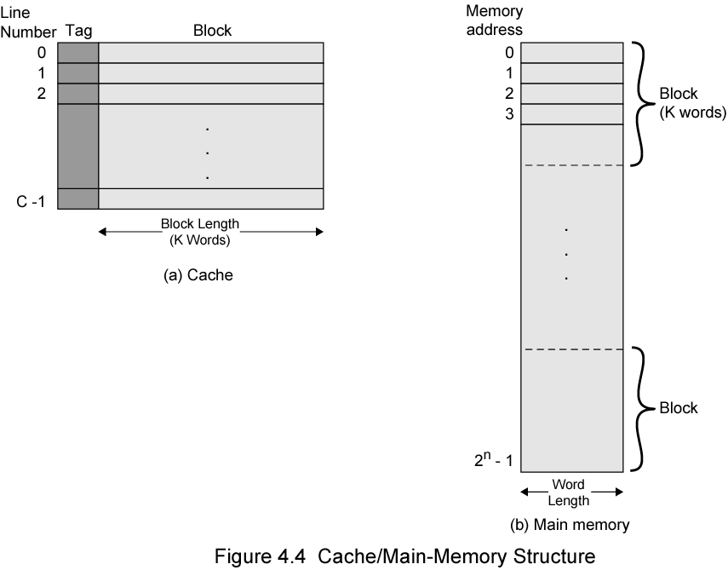
Cache/Main Memory Structure

Slide 22
Cache operation – overview
CPU requests contents of memory location
Check cache for this data
If present, get from cache (fast)
If not present, read required block from main memory to cache
Then deliver from cache to CPU
Cache includes tags to identify which block of main memory is in each cache slot

Slide 23
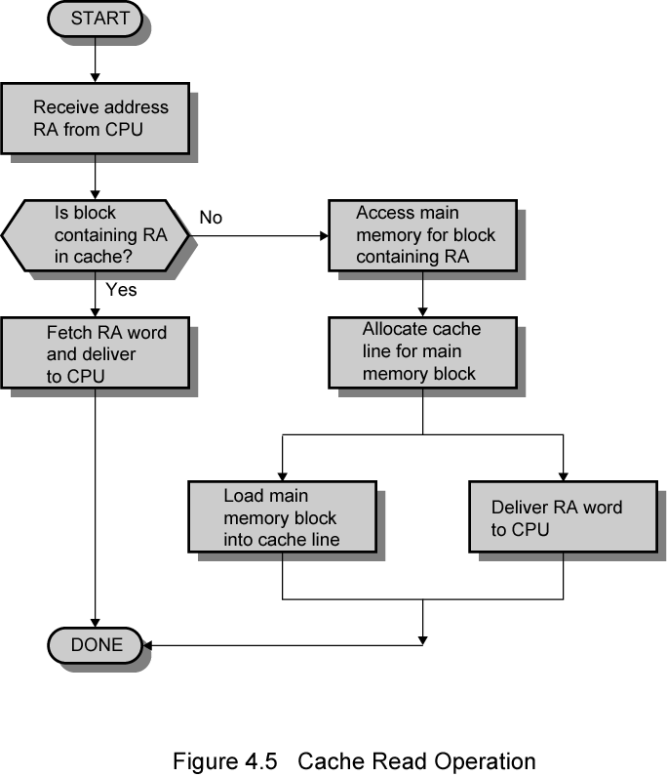
Cache Read Operation - Flowchart

Slide 24
Cache Design
Size
Mapping Function
Replacement Algorithm
Write Policy
Block Size
Number of Caches

Slide 25
Size does matter
Cost
  More cache is expensive
Speed
  More cache is faster (up to a point)
  Checking cache for data takes time

Slide 26

Typical Cache Organization

Slide 27
Comparison of Cache Sizes
Processor
Type
Year of Introduction
L1 cachea
L2 cache
L3 cache
IBM 360/85
Mainframe
1968
16 to 32 KB
—
—
PDP-11/70
Minicomputer
1975
1 KB
—
—
VAX 11/780
Minicomputer
1978
16 KB
—
—
IBM 3033
Mainframe
1978
64 KB
—
—
IBM 3090
Mainframe
1985
128 to 256 KB
—
—
Intel 80486
PC
1989
8 KB
—
—
Pentium
PC
1993
8 KB/8 KB
256 to 512 KB
—
PowerPC 601
PC
1993
32 KB
—
—
PowerPC 620
PC
1996
32 KB/32 KB
—
—
PowerPC G4
PC/server
1999
32 KB/32 KB
256 KB to 1 MB
2 MB
IBM S/390 G4
Mainframe
1997
32 KB
256 KB
2 MB
IBM S/390 G6
Mainframe
1999
256 KB
8 MB
—
Pentium 4
PC/server
2000
8 KB/8 KB
256 KB
—
IBM SP
High-end server/ supercomputer
2000
64 KB/32 KB
8 MB
—
CRAY MTAb
Supercomputer
2000
8 KB
2 MB
—
Itanium
PC/server
2001
16 KB/16 KB
96 KB
4 MB
SGI Origin 2001
High-end server
2001
32 KB/32 KB
4 MB
—
Itanium 2
PC/server
2002
32 KB
256 KB
6 MB
IBM POWER5
High-end server
2003
64 KB
1.9 MB
36 MB
CRAY XD-1
Supercomputer
2004
64 KB/64 KB
1MB
—
a Two values seperated by a slash refer to instruction and data caches
b Both caches are instruction only; no data caches

Slide 28
Mapping Function
Cache of 64kByte
Cache block of 4 bytes
  i.e. cache is 16k (2¹⁴) lines of 4 bytes
16MBytes main memory
24 bit address
  (2²⁴=16M)

Slide 29
Direct Mapping
Each block of main memory maps to only one cache line
  i.e. if a block is in cache, it must be in one specific place
Address is in two parts
Least Significant w bits identify unique word
Most Significant s bits specify one memory block
The MSBs are split into a cache line field r and a tag of s-r (most significant)

Slide 30
Direct Mapping
Address Structure
Tag s-r
Line or Slot r
Word w
8
14
2
24 bit address
2 bit word identifier (4 byte block)
22 bit block identifier
  8 bit tag (=22-14)
  14 bit slot or line
No two blocks in the same line have the same Tag field
Check contents of cache by finding line and checking Tag

Slide 31
Direct Mapping
Cache Line Table
Cache line Main Memory blocks held
0 0, m, 2m, 3m…2s-m
1 1,m+1, 2m+1…2s-m+1
m-1 m-1, 2m-1,3m-1…2s-1

Slide 32
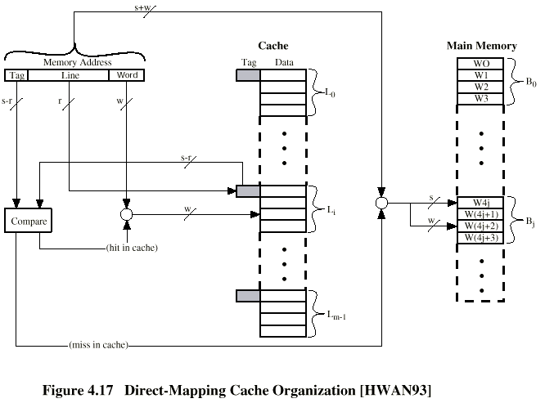
Direct Mapping Cache Organization

Slide 33
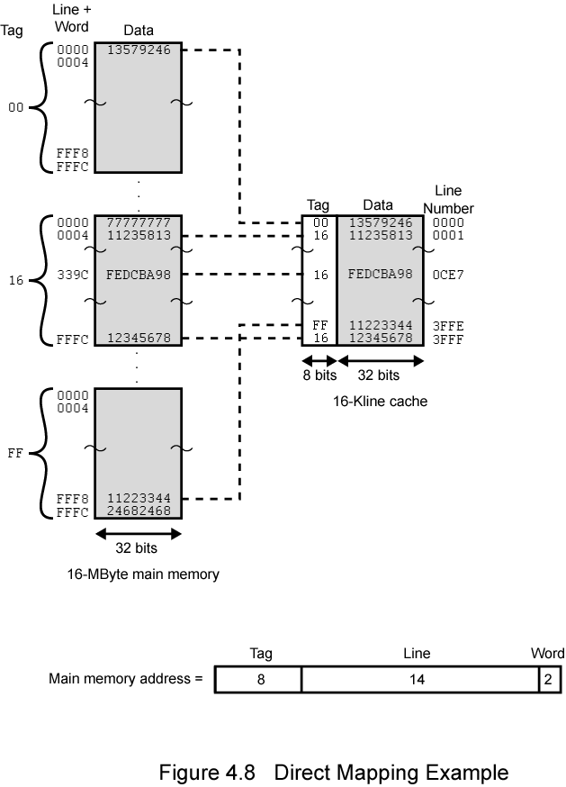
Direct Mapping
Example

Slide 34
Direct Mapping Summary
Address length = (s + w) bits
Number of addressable units = 2^{s+w} words or bytes
Block size = line size = 2^{w} words or bytes
Number of blocks in main memory = 2^{s+ w/2w} = 2^{s}
Number of lines in cache = m = 2^{r}
Size of tag = (s – r) bits

Slide 35
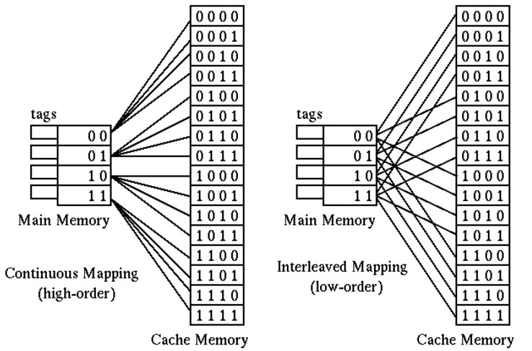
Direct Mapping example

Slide 36
Direct Mapping pros & cons
Simple
Inexpensive
Fixed location for given block
  If a program accesses 2 blocks that map to the same line repeatedly, cache misses are very high

Slide 37
Associative Mapping
A main memory block can load into any line of cache
Memory address is interpreted as tag and word
Tag uniquely identifies block of memory
Every line’s tag is examined for a match
Cache searching gets expensive

Slide 38

Fully Associative Cache Organization

Slide 39
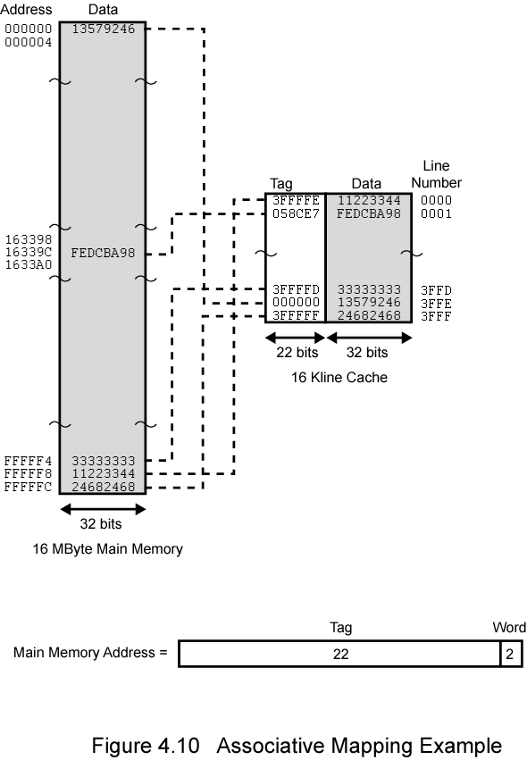
Associative
Mapping Example

Slide 40
Associative Mapping
Address Structure
Word
2 bit
Tag 22 bit
22 bit tag stored with each 32 bit block of data
Compare tag field with tag entry in cache to check for hit
Least significant 2 bits of address identify which 16 bit word is required from 32 bit data block
e.g.
  Address Tag Data Cache line
  FFFFFC FFFFFC 24682468 3FFF

Slide 41
Assignment MS
Get your self ready to identify the cache memory on main boards

Slide 42
Associative Mapping Summary
Address length = (s + w) bits
Number of addressable units = 2s+w words or bytes
Block size = line size = 2w words or bytes
Number of blocks in main memory = 2s+ w/2w = 2s
Number of lines in cache = undetermined
Size of tag = s bits

Slide 43
Set Associative Mapping
Cache is divided into a number of sets
Each set contains a number of lines
A given block maps to any line in a given set
  e.g. Block B can be in any line of set i
e.g. 2 lines per set
  2 way associative mapping
  A given block can be in one of 2 lines in only one set

Slide 44
Set Associative Mapping
Example
13 bit set number
Block number in main memory is modulo 2¹³
000000, 00A000, 00B000, 00C000 … map to same set

Slide 45
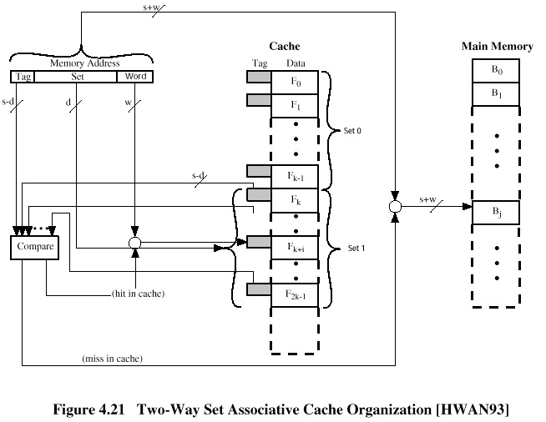
Two Way Set Associative Cache Organization

Slide 46
Set Associative Mapping
Address Structure
Word
2 bit
Tag 9 bit
Set 13 bit
Use set field to determine cache set to look in
Compare tag field to see if we have a hit
e.g
  Address Tag Data Set number
  1FF 7FFC 1FF 12345678 1FFF
  001 7FFC 001 11223344 1FFF

Slide 47
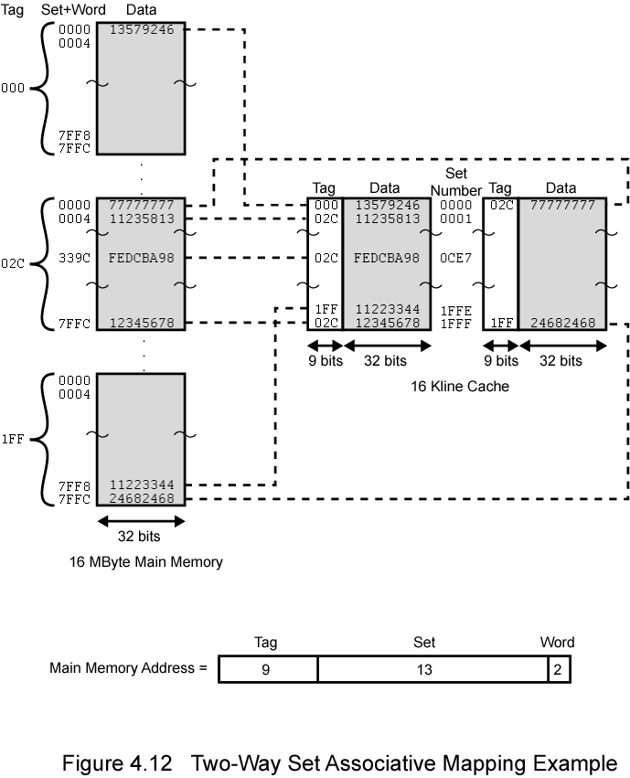
Two Way
Set
Associative
Mapping
Example

Slide 48
Set Associative Mapping Summary
Address length = (s + w) bits
Number of addressable units = 2s+w words or bytes
Block size = line size = 2w words or bytes
Number of blocks in main memory = 2d
Number of lines in set = k
Number of sets = v = 2d
Number of lines in cache = kv = k * 2d
Size of tag = (s – d) bits

Slide 49
Replacement Algorithms (1)
Direct mapping
No choice
Each block only maps to one line
Replace that line

Slide 50
Assignment # 2
Prepare your self to define the latest processors like I3,I5 and I7 especially their speeds, cache placements, number of ALUs, MMXs, Buss speeds, processes, capacities and finally recommend for some group of peoples (Business point of view)

Slide 51
Replacement Algorithms (2)
Associative & Set Associative
Hardware implemented algorithm (speed)
Least Recently used (LRU)
e.g. in 2 way set associative
  Which of the 2 block is lru?
First in first out (FIFO)
  replace block that has been in cache longest
Least frequently used
  replace block which has had fewest hits
Random

Slide 52
Write Policy
Must not overwrite a cache block unless main memory is up to date
Multiple CPUs may have individual caches
I/O may address main memory directly

Slide 53
Write through
All writes go to main memory as well as cache
Multiple CPUs can monitor main memory traffic to keep local (to CPU) cache up to date
Lots of traffic
Slows down writes
Remember bogus write through caches!

Slide 54
Write back
Updates initially made in cache only
Update bit for cache slot is set when update occurs
If block is to be replaced, write to main memory only if update bit is set
Other caches get out of sync
I/O must access main memory through cache
N.B. 15% of memory references are writes

Slide 55
Pentium 4 Cache
80386 – no on chip cache
80486 – 8k using 16 byte lines and four way set associative organization
Pentium (all versions) – two on chip L1 caches
  Data & instructions
Pentium III – L3 cache added off chip
Pentium 4
  L1 caches
    8k bytes
    64 byte lines
    four way set associative
  L2 cache
    Feeding both L1 caches
    256k
    128 byte lines
    8 way set associative
  L3 cache on chip

Slide 56
Intel Cache Evolution
Problem
Solution
Processor on which feature first appears
External memory slower than the system bus.
Add external cache using faster memory technology.
386
Increased processor speed results in external bus becoming a bottleneck for cache access.
Move external cache on-chip, operating at the same speed as the processor.
486
Internal cache is rather small, due to limited space on chip
Add external L2 cache using faster technology than main memory
486
Contention occurs when both the Instruction Prefetcher and the Execution Unit simultaneously require access to the cache. In that case, the Prefetcher is stalled while the Execution Unit’s data access takes place.
Create separate data and instruction caches.
Pentium
Increased processor speed results in external bus becoming a bottleneck for L2 cache access.
Create separate back-side bus that runs at higher speed than the main (front-side) external bus. The BSB is dedicated to the L2 cache.
Pentium Pro
Move L2 cache on to the processor chip.
Pentium II
Some applications deal with massive databases and must have rapid access to large amounts of data. The on-chip caches are too small.
Add external L3 cache.
Pentium III
Move L3 cache on-chip.
Pentium 4

Slide 57
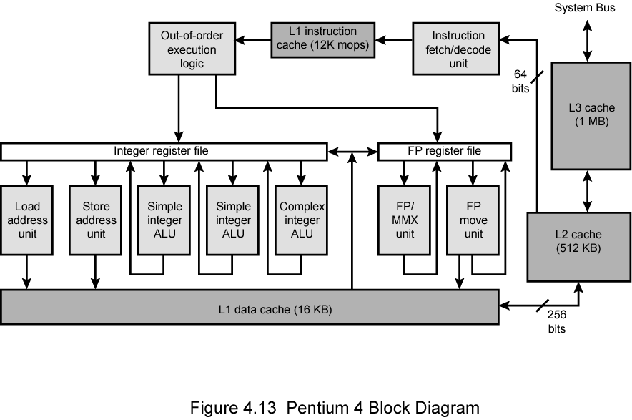
Pentium 4 Block Diagram

Slide 58
Pentium 4 Core Processor
Fetch/Decode Unit
  Fetches instructions from L2 cache
  Decode into micro-ops
  Store micro-ops in L1 cache
Out of order execution logic
  Schedules micro-ops
  Based on data dependence and resources
  May speculatively execute
Execution units
  Execute micro-ops
  Data from L1 cache
  Results in registers
Memory subsystem
  L2 cache and systems bus

Slide 59
Pentium 4 Design Reasoning
Decodes instructions into RISC like micro-ops before L1 cache
Micro-ops fixed length
  Superscalar pipelining and scheduling
Pentium instructions long & complex
Performance improved by separating decoding from scheduling & pipelining
  (More later – ch14)
Data cache is write back
  Can be configured to write through
L1 cache controlled by 2 bits in register
  CD = cache disable
  NW = not write through
  2 instructions to invalidate (flush) cache and write back then invalidate
L2 and L3 8-way set-associative
  Line size 128 bytes

Slide 60
PowerPC Cache Organization
601 – single 32kb 8 way set associative
603 – 16kb (2 x 8kb) two way set associative
604 – 32kb
620 – 64kb
G3 & G4
  64kb L1 cache
    8 way set associative
  256k, 512k or 1M L2 cache
    two way set associative
G5
  32kB instruction cache
  64kB data cache

Slide 61
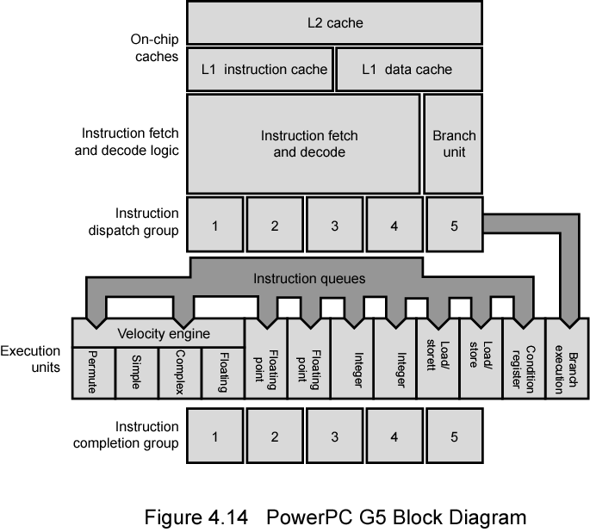
PowerPC G5 Block Diagram

Slide 62
Internet Sources
Manufacturer sites
  Intel
  IBM/Motorola
Search on cache

Slide 63
Exercise Problems
4.1 What are the differences among sequential access, direct access, and random access?
4.2 What is the general relationship among access time, memory cost, and capacity?
4.3 How does the principle of locality relate to the use of multiple memory levels?
4.4 What are the differences among direct mapping, associative mapping, and setassociative mapping?
4.5 For a direct-mapped cache, a main memory address is viewed as consisting of three fields. List and define the three fields.
4.6 For an associative cache, a main memory address is viewed as consisting of two fields. List and define the two fields.
4.7 For a set-associative cache, a main memory address is viewed as consisting of three fields. List and define the three fields.
4.8 What is the distinction between spatial locality and temporal locality?
4.9 In general, what are the strategies for exploiting spatial locality and temporal locality?
Notes:
4.1 Sequential access: Memory is organized into units of data, called records. Access
must be made in a specific linear sequence. Direct access: Individual blocks or
records have a unique address based on physical location. Access is accomplished
by direct access to reach a general vicinity plus sequential searching, counting, or
waiting to reach the final location. Random access: Each addressable location in
memory has a unique, physically wired-in addressing mechanism. The time to
access a given location is independent of the sequence of prior accesses and is
constant.
4.2 Faster access time, greater cost per bit; greater capacity, smaller cost per bit; greater
capacity, slower access time.
4.3 It is possible to organize data across a memory hierarchy such that the percentage
of accesses to each successively lower level is substantially less than that of the level
above. Because memory references tend to cluster, the data in the higher-level
memory need not change very often to satisfy memory access requests.
4.4 In a cache system, direct mapping maps each block of main memory into only one
possible cache line. Associative mapping permits each main memory block to be
loaded into any line of the cache. In set-associative mapping, the cache is divided
into a number of sets of cache lines; each main memory block can be mapped into
any line in a particular set.
4.5 One field identifies a unique word or byte within a block of main memory. The
remaining two fields specify one of the blocks of main memory. These two fields
are a line field, which identifies one of the lines of the cache, and a tag field, which
identifies one of the blocks that can fit into that line.
4.6 A tag field uniquely identifies a block of main memory. A word field identifies a
unique word or byte within a block of main memory.
4.7 One field identifies a unique word or byte within a block of main memory. The
remaining two fields specify one of the blocks of main memory. These two fields
are a set field, which identifies one of the sets of the cache, and a tag field, which
identifies one of the blocks that can fit into that set.
4.8 Spatial locality refers to the tendency of execution to involve a number of memory
locations that are clustered. Temporal locality refers to the tendency for a processor
to access memory locations that have been used recently.
4.9 Spatial locality is generally exploited by using larger cache blocks and by
incorporating prefetching mechanisms (fetching items of anticipated use) into the

Slide 64
